Slide 1
Data Wrangling with Baltimore City 911 Report Data
Harshith Martha
TZ18899

Slide 2
Dataset:
The dataset used is ‘Baltimore911.csv’. The Link for the same is mentioned below:
https://drive.google.com/file/d/1et5xb7SqEpDeH9BETENjKCl5HNX3mbAM/view?usp=drive_link

Slide 3
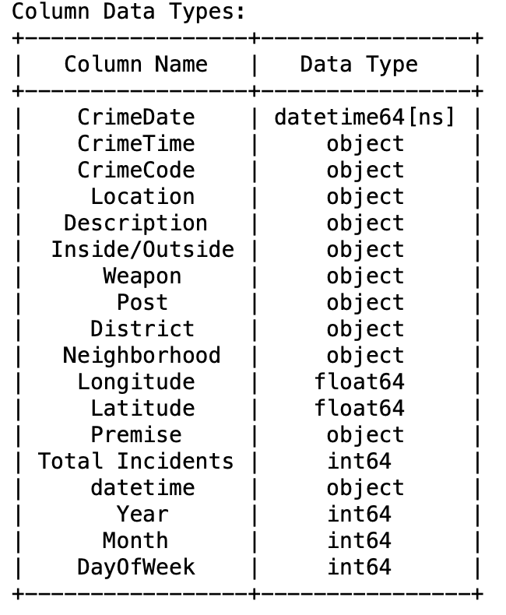
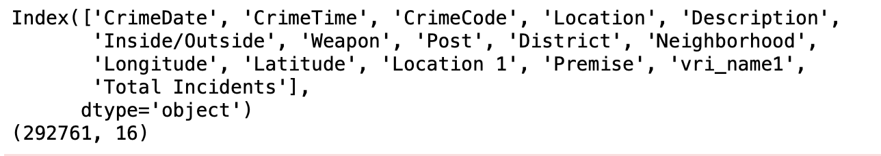
Attribute name and it’s datatype.
TASK 1
The total number of attributes/columns and rows or instances are 16 and 292761 respectively.

Slide 4
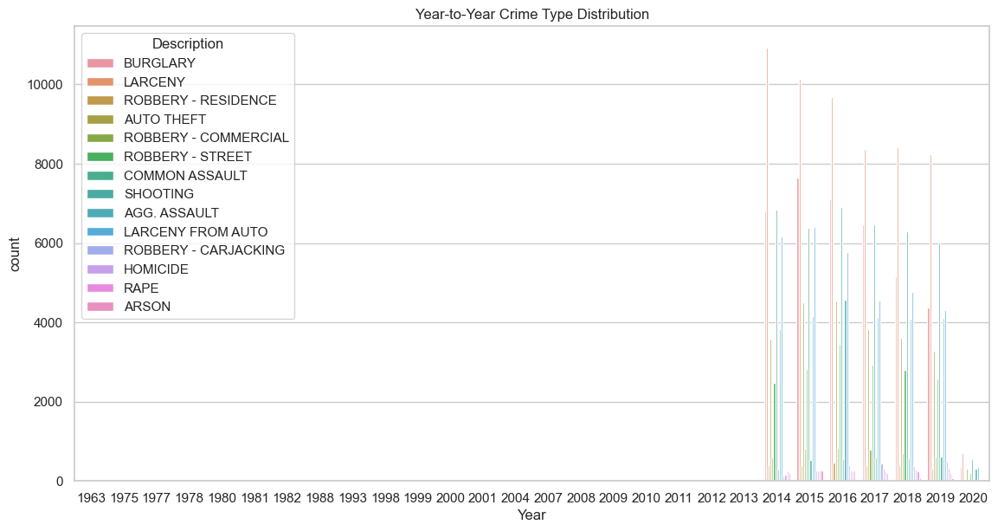
Crime Type Variation Analysis
Year to Year Crime Type Distribution

Slide 5
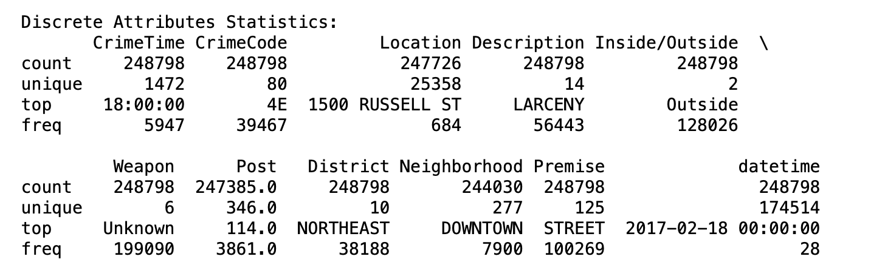
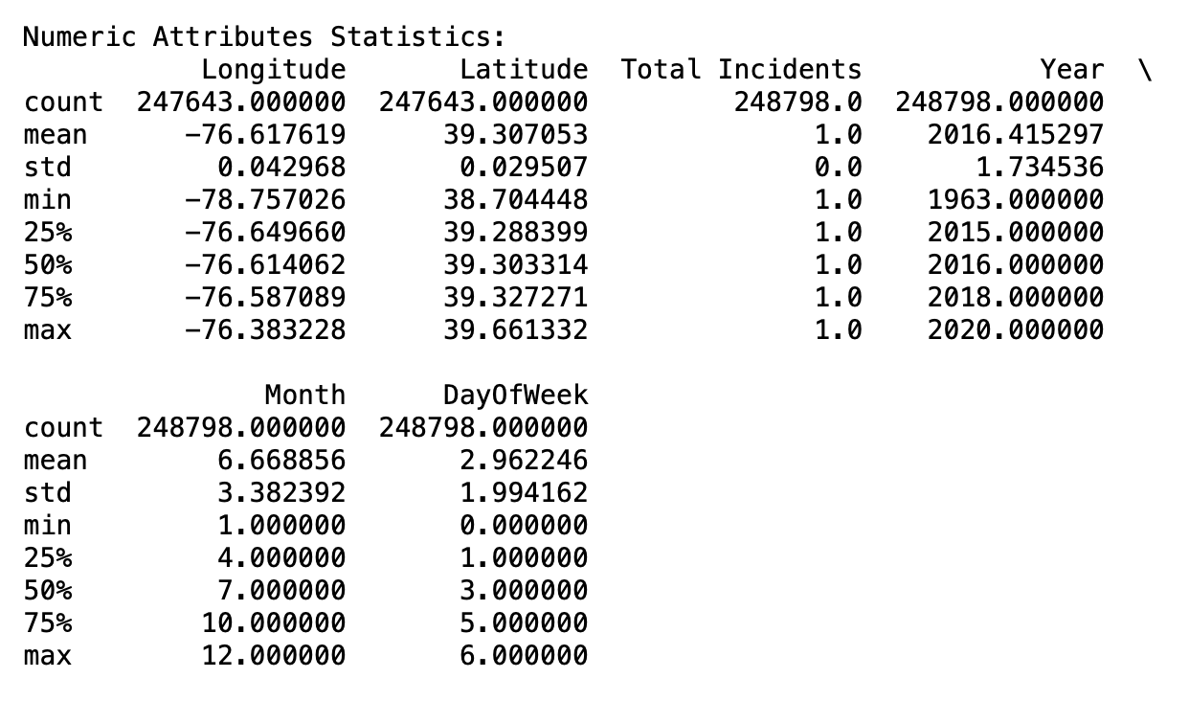
Statistics of Discrete and Numerical Attributes
The row named as “50%”in the table is the Median(The middle most value).

Slide 6
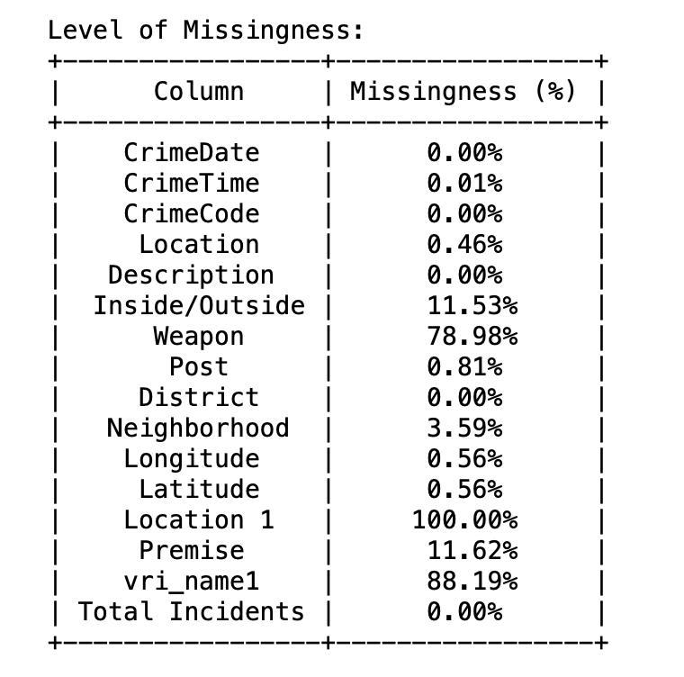
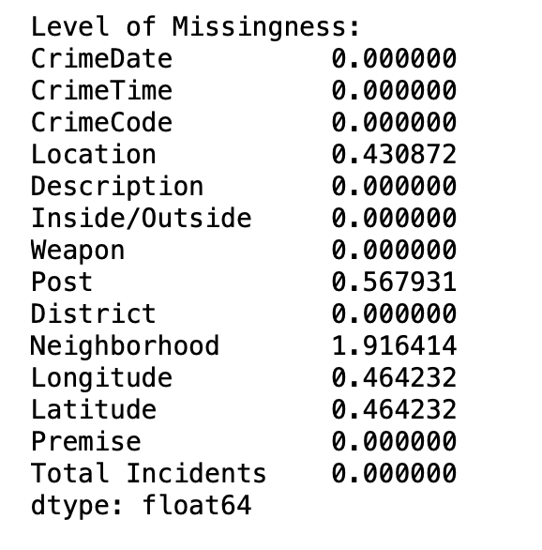
Before data cleaning.
After data cleaning.
The location 1 attribute has been dropped and later on the rows with missing values have been dropped and the number of instances have come down to 258723.
The level of missingness is shown below for every attribute. It is observed that Location 1 missing value is 100% which tells that the attribute consists of no values. It can be further dropped for better analysis.

Slide 7
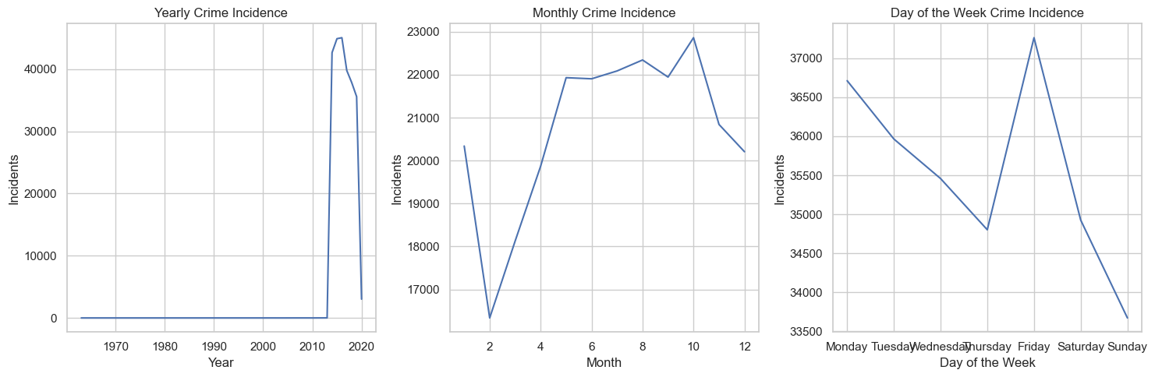
Temporal Pattern Analysis:

Slide 8
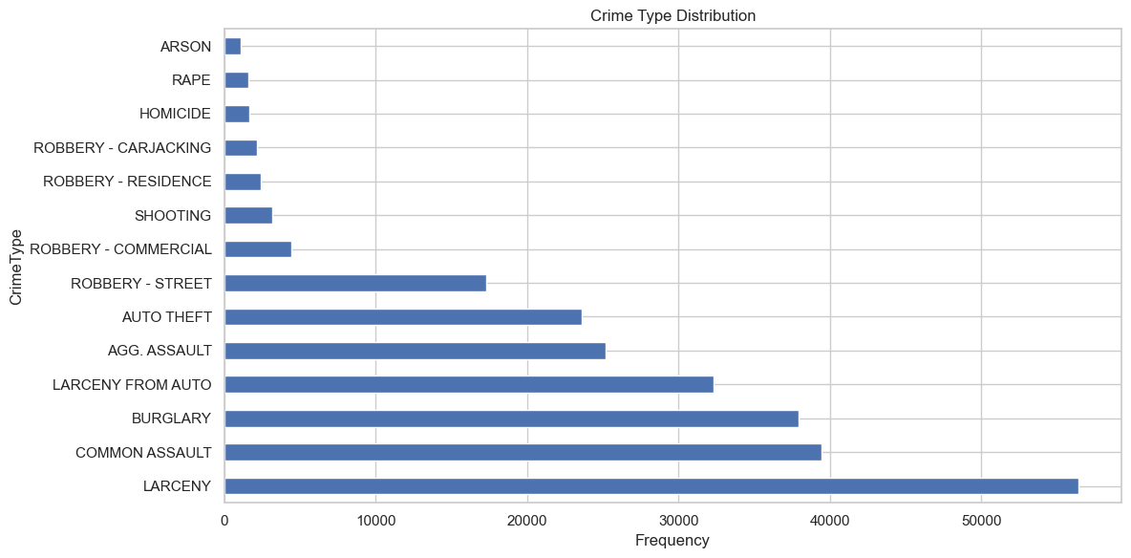
Crime Type Distribution:
It can be noted that larceny is most frequently and the arson is the most rarely occurring crime.

Slide 9
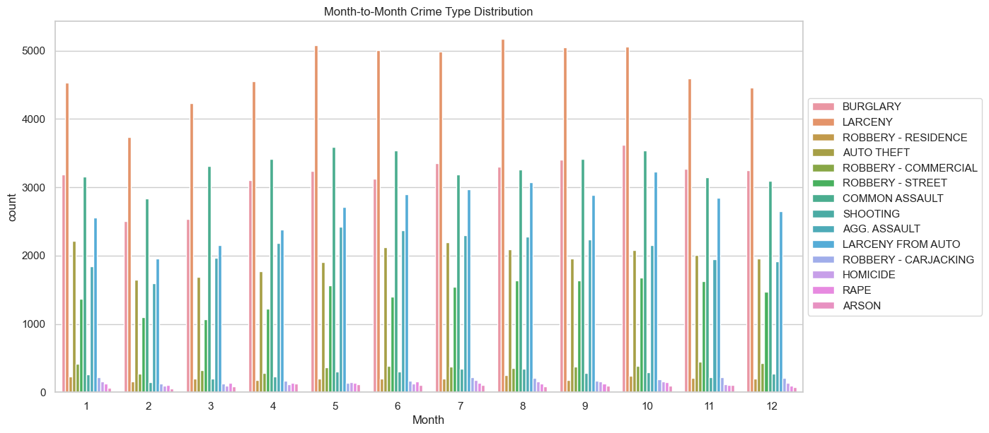
s
Month to Month Crime Distribution

Slide 10
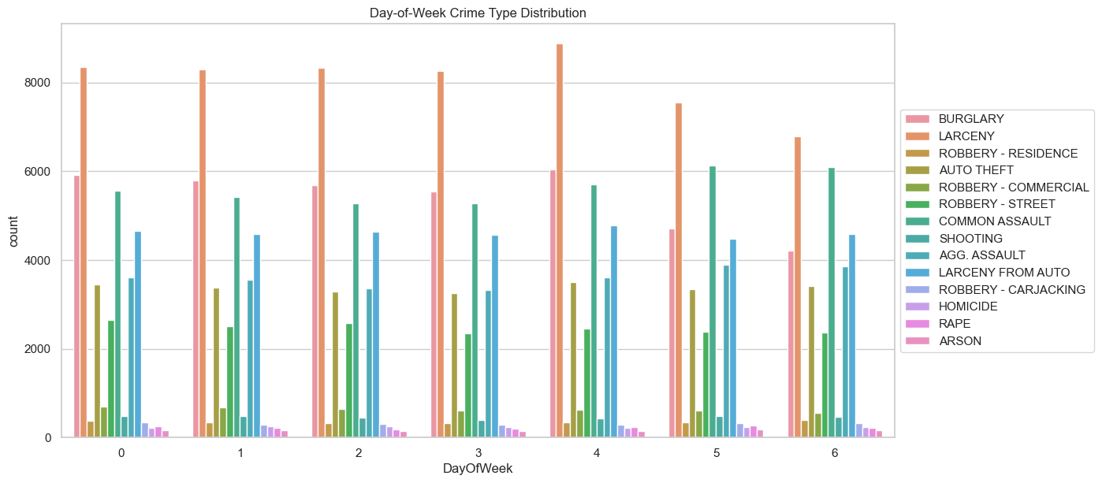
Crime Type Variation Analysis
Day of Week Crime Type Distribution
O to 6 on the x-axis represents days from Monday to Sunday accordingly.
It is observed Larceny crime is the most common one and the highest frequency of that particular one is recorded on 5th day of the week i.e.. Friday

Slide 11
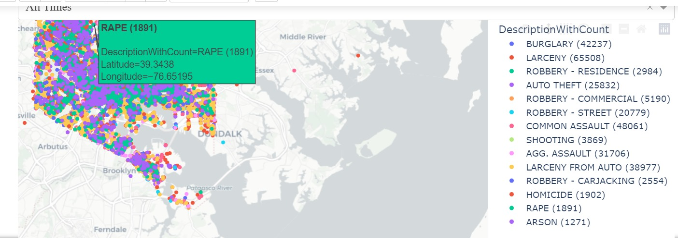
Dashboard Creation
Here, the dashboard is represented with all types of crimes distinguished according to the different colors as per the legend. The crime type and the frequency can be noted from it.

Slide 12
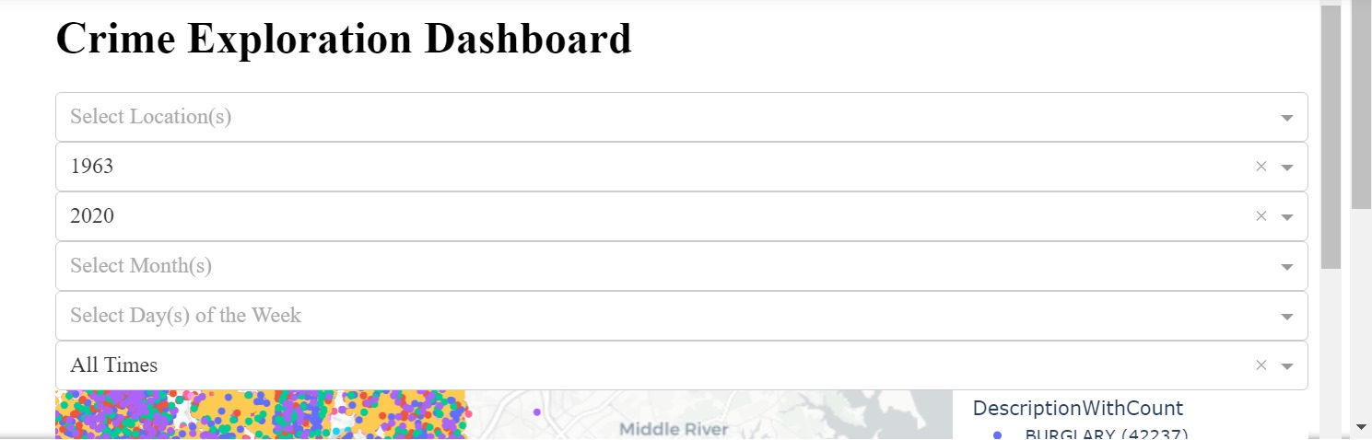
Dynamic Dashboard
The dynamic dashboard allows the users to change the parameters and observe the pattern.

